Slide 1

Non Functional aspects of web
Aruna S
Department of
Computer Science and Engineering

Slide 2

Non functional aspects of web
Compression
S. Aruna
Department of Computer Science and Engineering

Slide 3
Compression
Introduction
Compression is an important way to increase the performance of a Web site.
For some documents, size reduction of up to 70% lowers the bandwidth capacity needs. Over the years, algorithms also got more efficient, and new ones are supported by clients and servers.
Compression happens at three different levels:
File formats are compressed with specific optimized methods,
General encryption can happen at the HTTP level (the resource is transmitted compressed from end to end),
Compression can be defined at the connection level, between
two nodes of an HTTP connection.

Slide 4
Compression
File Format Compression
Compression algorithms used for files can be grouped into two broad categories:
Loss-less compression, where the compression-uncompression cycle doesn't alter the data that is recovered.
For images, gif or png are using loss-less compression.
Lossy compression, where the cycle alters the original data in a (hopefully) imperceptible way for the user. Video formats on the Web are lossy; the jpeg image format is also lossy.
Lossy compression algorithms are usually more efficient than loss-less ones.

Slide 5
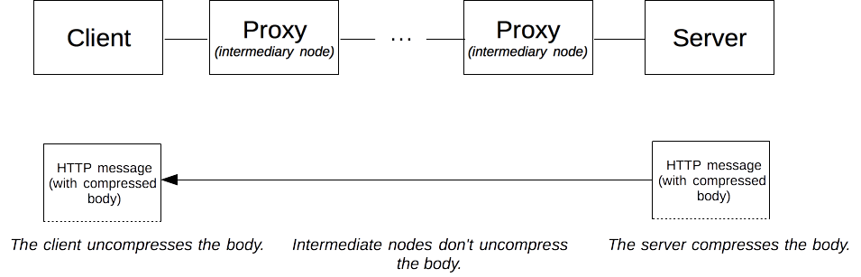
Compression
End to End Compression
End-to-end compression refers to a compression of the body of a message that is done by the server and will last unchanged until it reaches the client. Whatever the intermediate nodes are, they leave the body untouched.
Two relevant algorithms : gzip and br

Slide 6
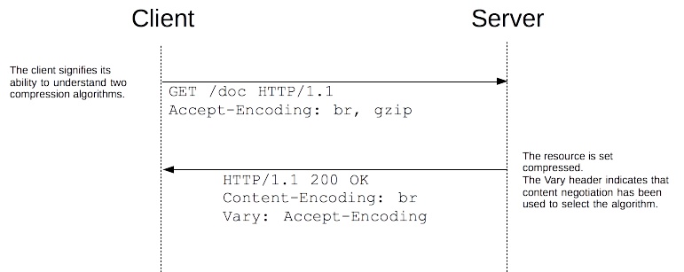
Compression
End to End Compression
The browser sends an Accept-Encoding header with the algorithm it supports and its order of precedence, the server picks one, uses it to compress the body of the response and uses the Content-Encoding header to tell the browser the algorithm it has chosen.
As content negotiation has been used to choose a representation based on its encoding, the server must send a Vary header containing at least Accept-Encoding alongside this header in the response

Slide 7
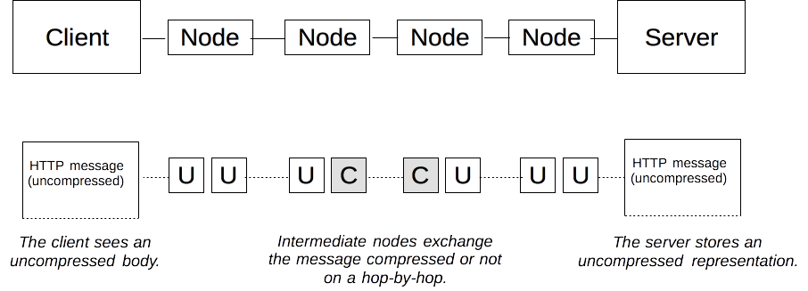
Compression
Hop by Hop Compression
Hop by Hop compression doesn't happen on the resource in the server, creating a specific representation that is then transmitted, but on the body of the message between any two nodes on the path between the client and the server.
Connections between successive intermediate nodes may apply a different compression.

Slide 8
Compression
Hop by Hop Compression
The node transmitting the request advertizes its will using the TE header and the other node chooses the adequate method, applies it, and indicates its choice with the Transfer-Encoding header.
hop-by-hop compression is transparent for the server and the client, and is rarely used.
TE and Transfer-Encoding are mostly used to send a response by chunks, allowing to start transmitting a resource without knowing its length.
Using Transfer-Encoding and compression at the hop level is so rare that most servers, like Apache, nginx, or IIS, have no easy way to configure it.
Such configuration usually happens at the proxy level.

Slide 9
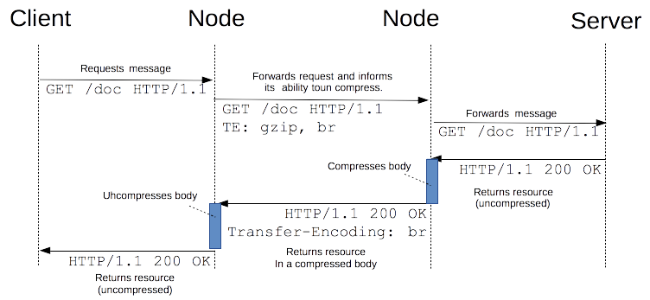
Compression
Hop by Hop Compression – Transfer Encoding

Slide 10
THANK YOU
Aruna S
Department of
Computer Science and Engineering
arunas@pes.edu

